Slide 1
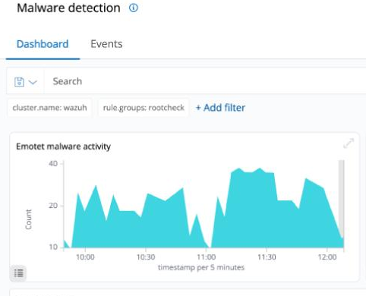
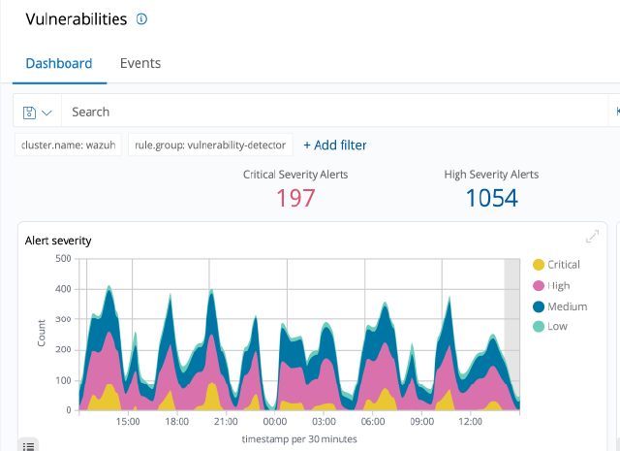
Malware Threats to Energy Sector
Author Muhammad Abdullah
Abstract
Methodology
Objectives
The advent of the digital age has brought rapid changes in key organizational management areas such as business network integration and supply chain management. Indeed, a core concern for most business executives today remains securing critical data. Among the sectors of the global economy that faces unprecedented cybersecurity challenges is energy. That is because energy delivery systems comprise both IT infrastructures and physical systems. Thus, tackling cybercrimes and threats in this industry remains an issue of grave concern, given the importance of energy to national and regional security interests.
Just a few of the infrastructure areas where nations have implemented critical systems include oil and gas, transportation, water treatment and distribution, emergency services, dams, electric power generation, and nuclear power plants.
To conduct research on the energy sector regarding the malware attacks and threats as well as making an undetectable virus.
Conclusion
I would like to finish up saying that I have clearly explained questions, research destinations, speculation to be tried and the purpose behind choosing the relevant topic.
Introduction
Results
the energy sector has proven incredibly vulnerable to cybersecurity threats in recent years. At the same time, most of these energy organizations have decentralized cybersecurity leadership structures, making it challenging to coordinate effective security strategies.
undetectable virus that hackers employ to access sensitive data on a device, rendering the files and systems that utilize the data inaccessible to the user or organization until they pay a ransom to unlock it.
Discussion
Due to their geographical spread and organizational complexity, particularly the decentralized nature of many firms' cyber security leadership, utilities have a vast and growing attack surface

